Slide 1

KDE Project Presentation
Hugo Moura
Tomás Carrilho
Stylianos Psara
Ziv Hochman
Panagiotis Andrikopoulos

Slide 2


Introduction
Motorsports
Semantic Web Technologies
RDF Knowledge base
SPARQL queries
Linking knowledge
Embeddings

Slide 3
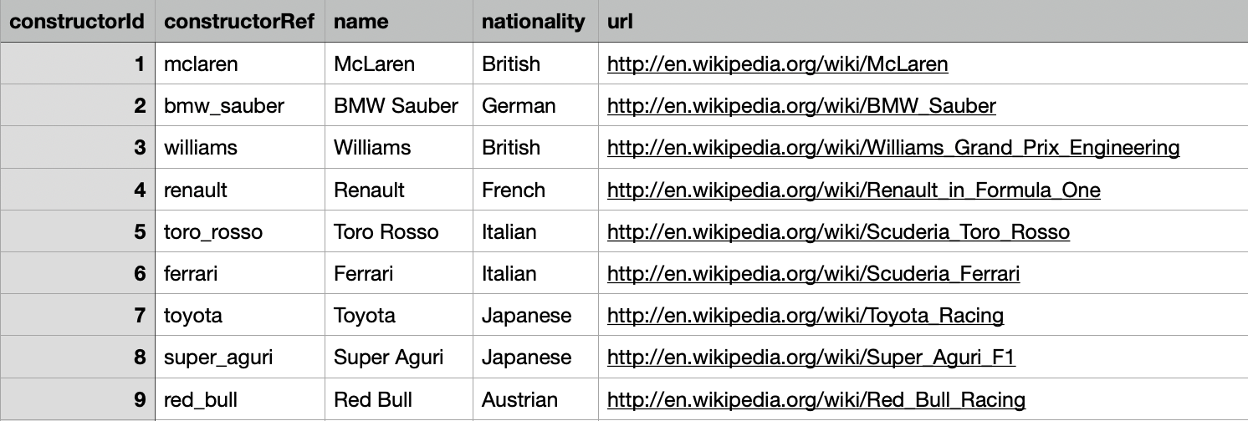
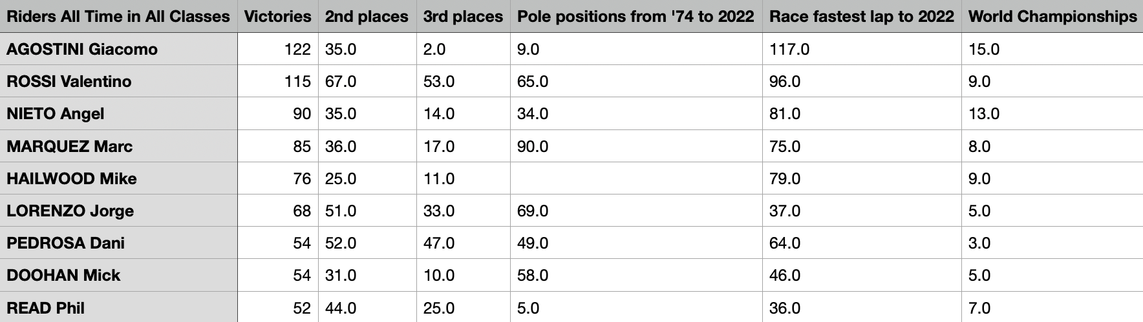
Datasets
F1
MotoGP
public dataset accessible in Kaggle

Slide 4
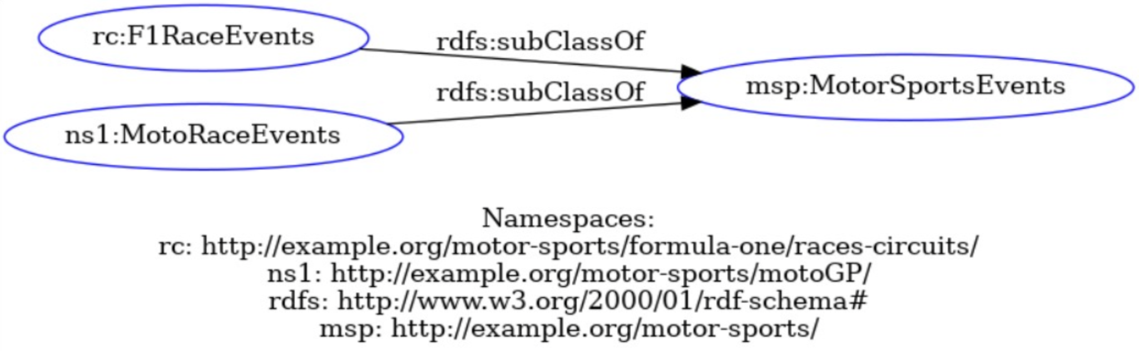
Building an Integrated RDF Knowledge Base
Graphs combination
Namespace http://example.org/motor-sports/ creation as the unified prefix for both graphs.
OWL axioms implementation to create classes and subclasses relationships for MotorSportsEvents, Constructors and Racers.
unified the classes F1RaceEvents and MotoRaceEvents under the common class MotorSportsEvents.
F1Constructor and MotoGPConstructor were placed under the class Constructors.
Driver and Rider were placed under the class Racer

Slide 5
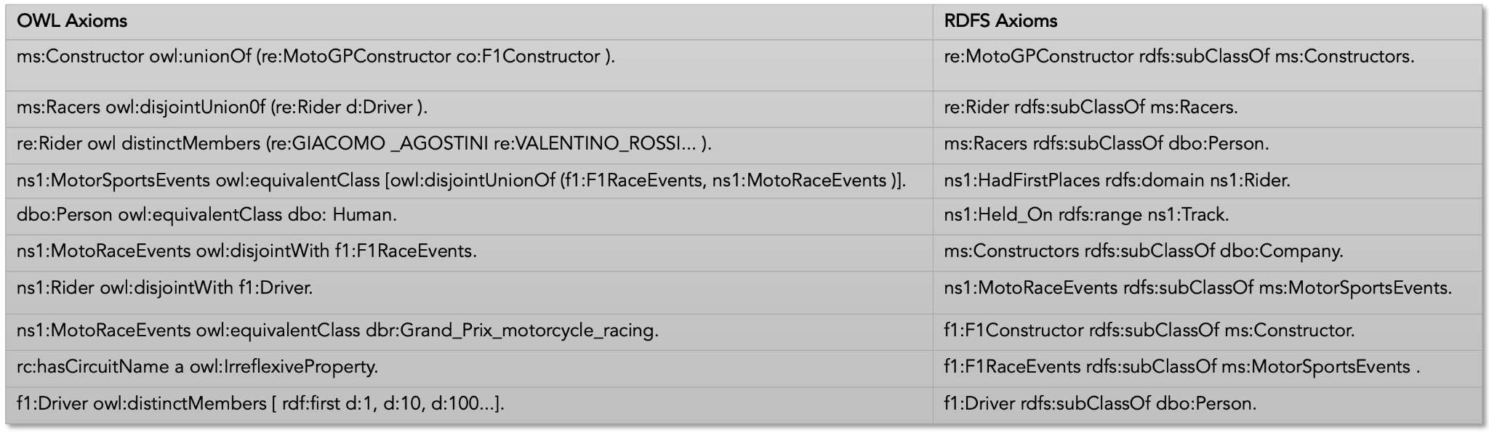
General axioms

Slide 6
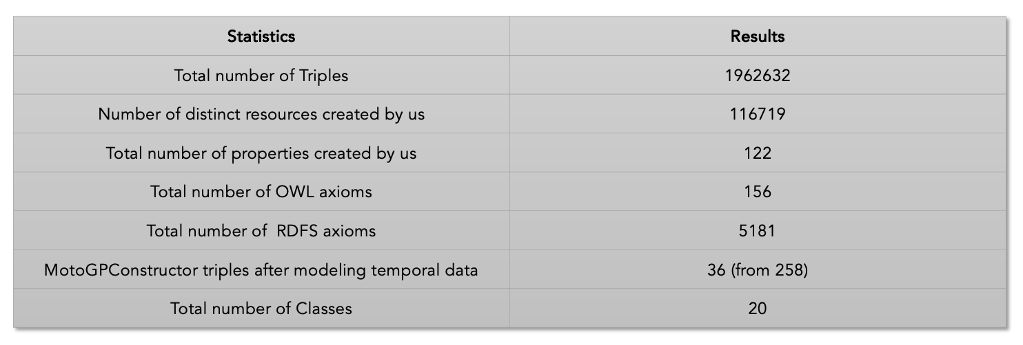
Statistics

Slide 7
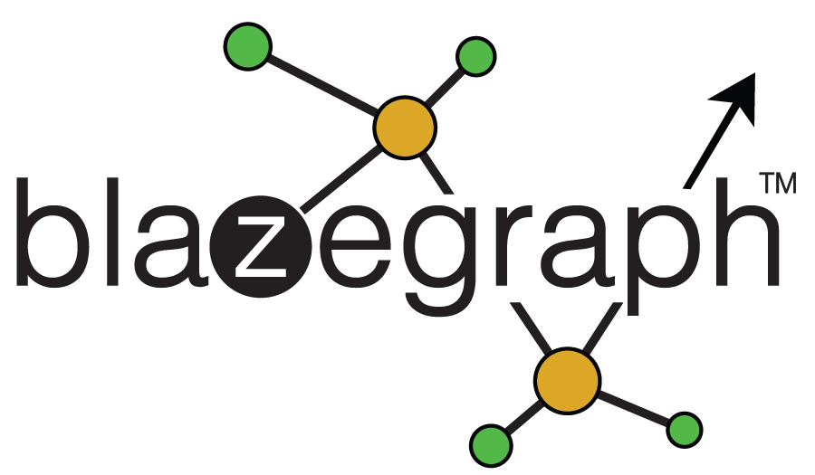
Building an Integrated RDF Knowledge Base (cont.)
Blazegraph
perform more efficient and faster searches using SPARQL queries

Slide 8


Linking knowledge with DBpedia and Wikidata
MotoGP Tracks with the Dbpedia
MotoGP Riders with Wikidata and DBpedia

Slide 9
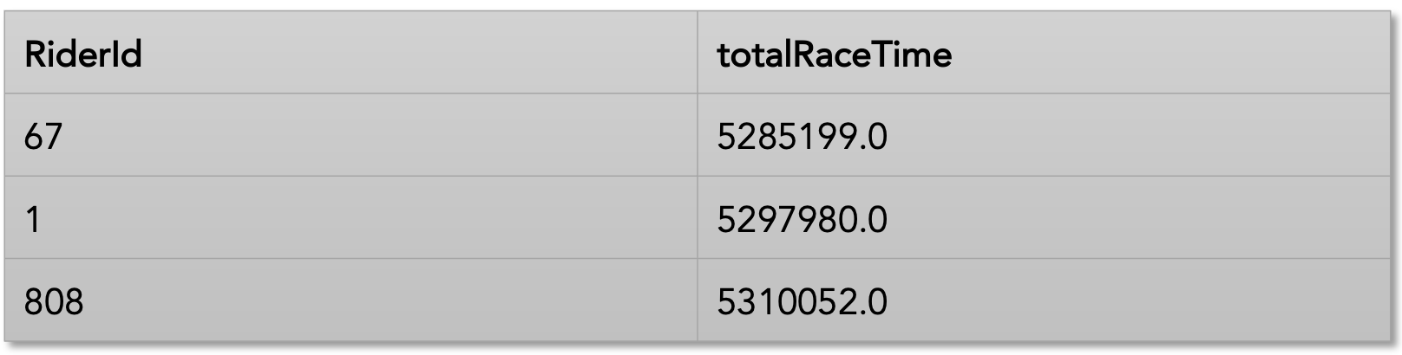
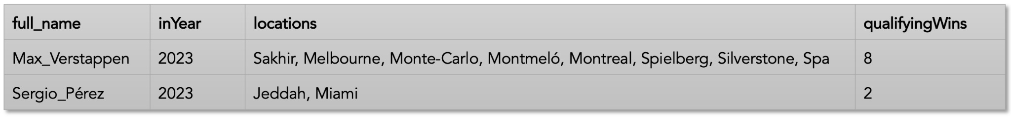
SPARQL queries (F1)
The drivers (and their total time) that would have been passed by driver with ID=20 (can be any driver) in race with ID=841 (can be any race), if he hadn’t stopped at any pitstop
Qualifying winners, number of times per year

Slide 10
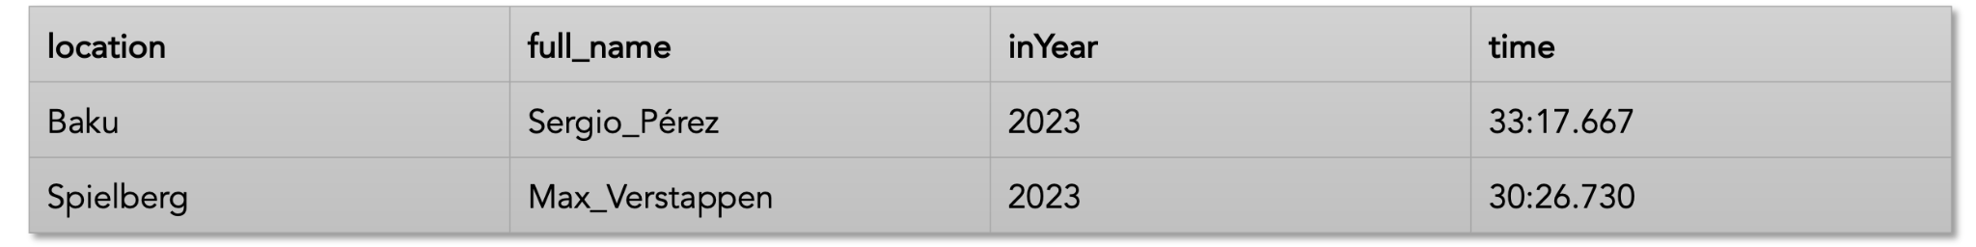
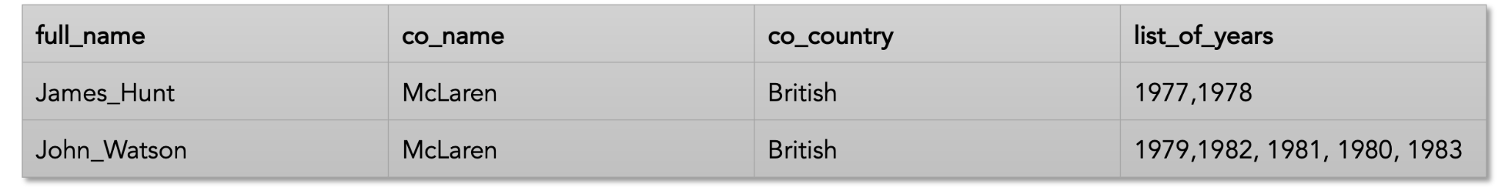
SPARQL queries (F1)
Sprint winners in all seasons
Which drivers drove for a constructor from their country and in which season?

Slide 11
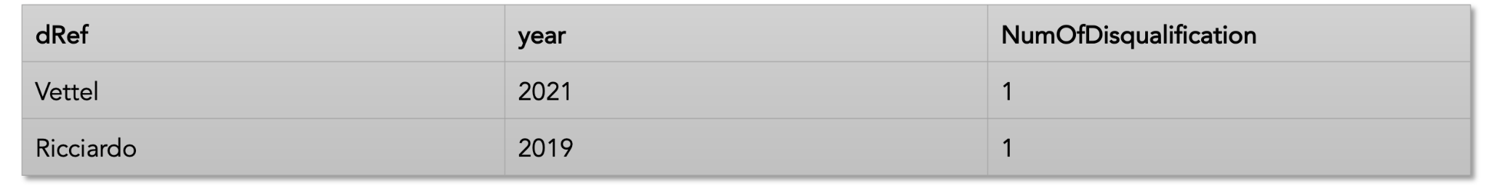
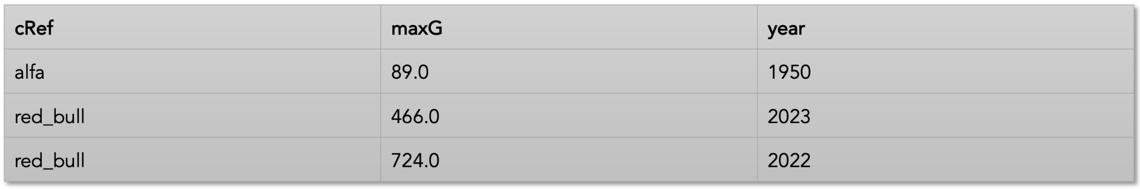
SPARQL queries (F1)
Number of disqualifications for a driver per season
Constructor winners per season

Slide 12
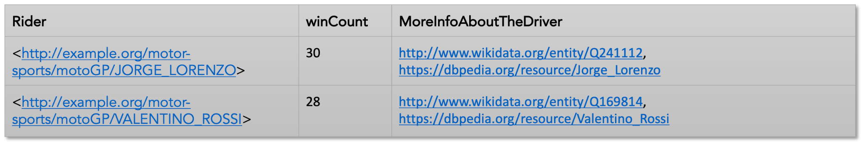
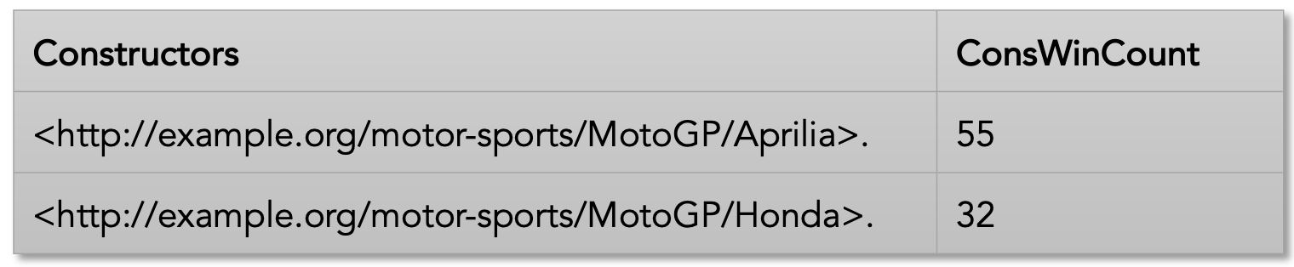
SPARQL queries (MotoGP)
Top six riders with the most wins in their country
Top five constructors with italian drivers with the most wins before 2005 in 250cc Class

Slide 13
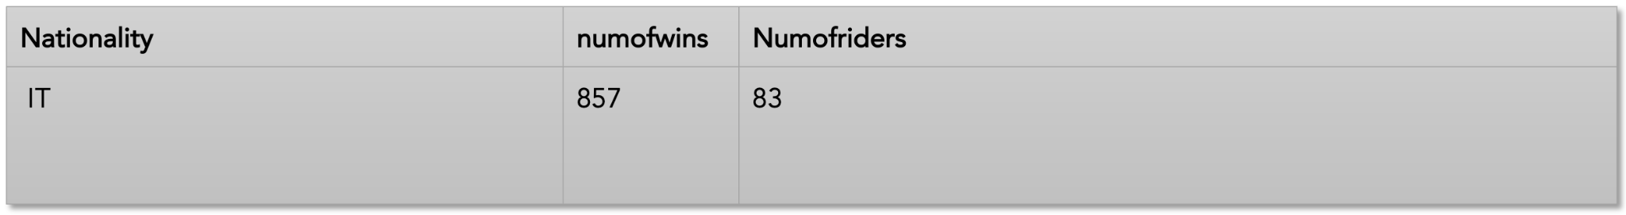
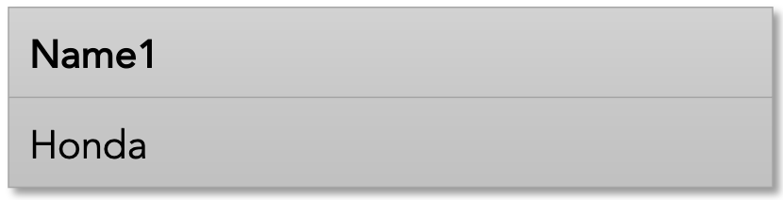
SPARQL queries (MotoGP and F1)
Which country has the riders with most wins in MotoGP, how many are the wins and the drivers
MotoGP and F1 constructors

Slide 14
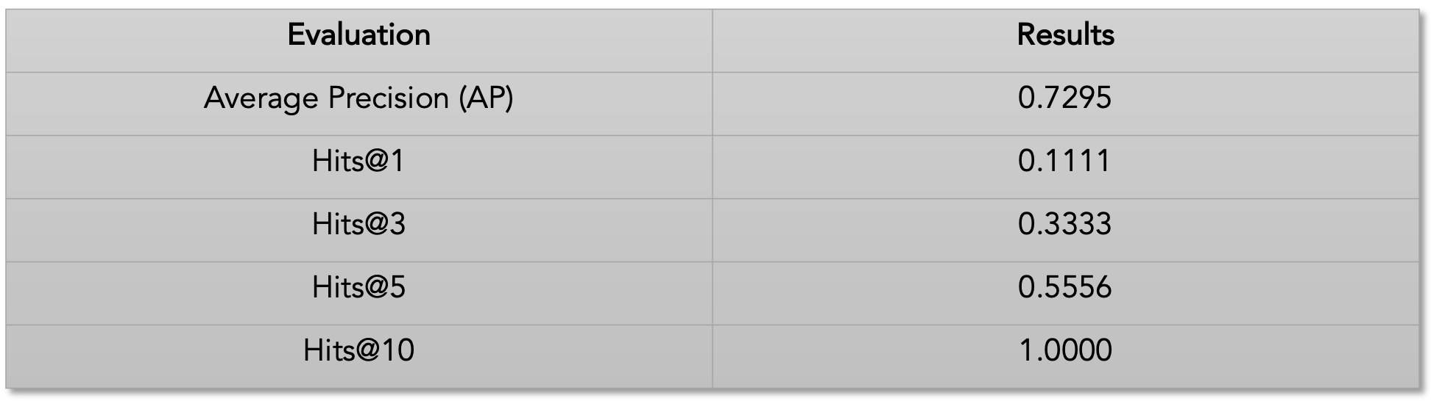
Embeddings generation
TransE class implementation with TorchE library, employing a neural network as the machine learning model.

Slide 15
Embeddings example
co:27
Status
Turbo
subject
relation
object

Slide 16

Conclusion
Limitations
Limitations of the RDF data model and semantic web technologies
Modeling relationships;
Human interpretation;
Data evolution and adaptation.
Overall project limitations
What are the challenges for the semantic web?
Future in the era of generative AI?

Slide 17

Questions?
Thanks for listening :)

